Slide 1
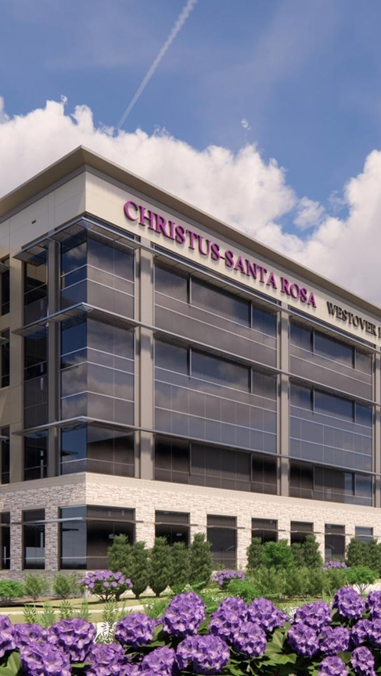


OPPORTUNITY REVIEW
DIRECT-TO-EMPLOYER GTM STRATEGY
Exploring a CHRISTUS Health DTE Health Plan

Slide 2


Founded in 1979, headquartered in Indianapolis
Largest Independently-Owned Full-Service Third-Party Administrator
Specialize in Administration of Self-Funded Plans and Population Health Management​
Leader in the Direct-to-Employer Movement
We Know and Understand the Market
Experience Working with All Professional Teams: Agents, Networks, MGAs
The Key Family of Companies is a Vertically Integrated group of benefit related organizations
3,000+ Corporate Clients
3 Million Members under Management
700 Employees

Slide 3
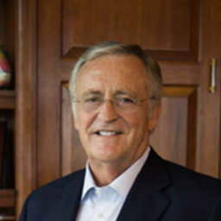

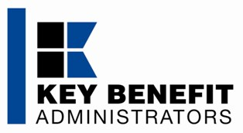
Our Founding and Heritage: 47 Years of Striving for Honesty in Healthcare

Slide 4
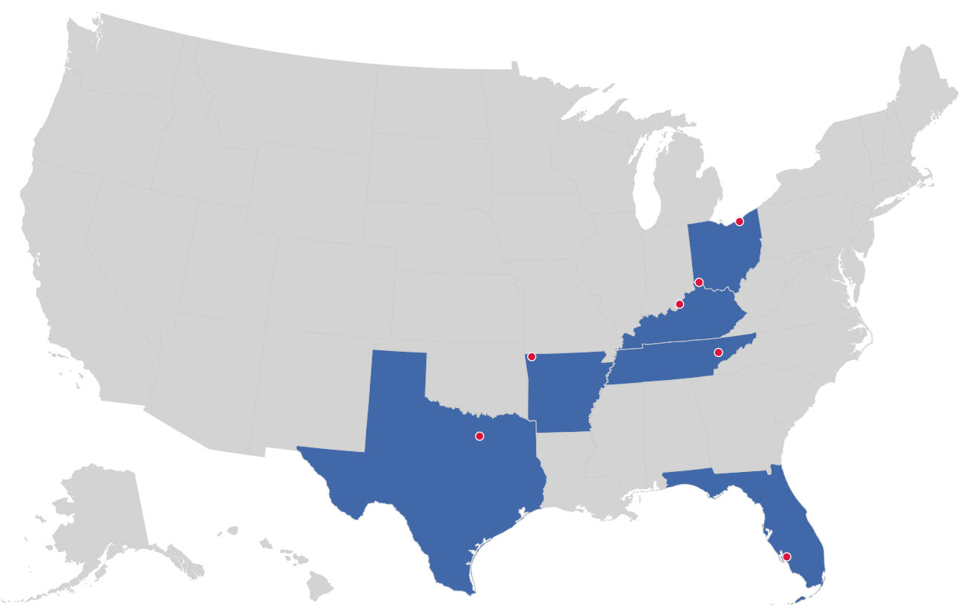

MARKET LEADER
IN
PRIVATE LABELED
DTE PLANS
Cleveland, OH
Louisville, KY
Cincinnati, OH
Bentonville, AR
Knoxville, TN
Dallas Fort Worth, TX
Fort Myers, FL

Slide 5
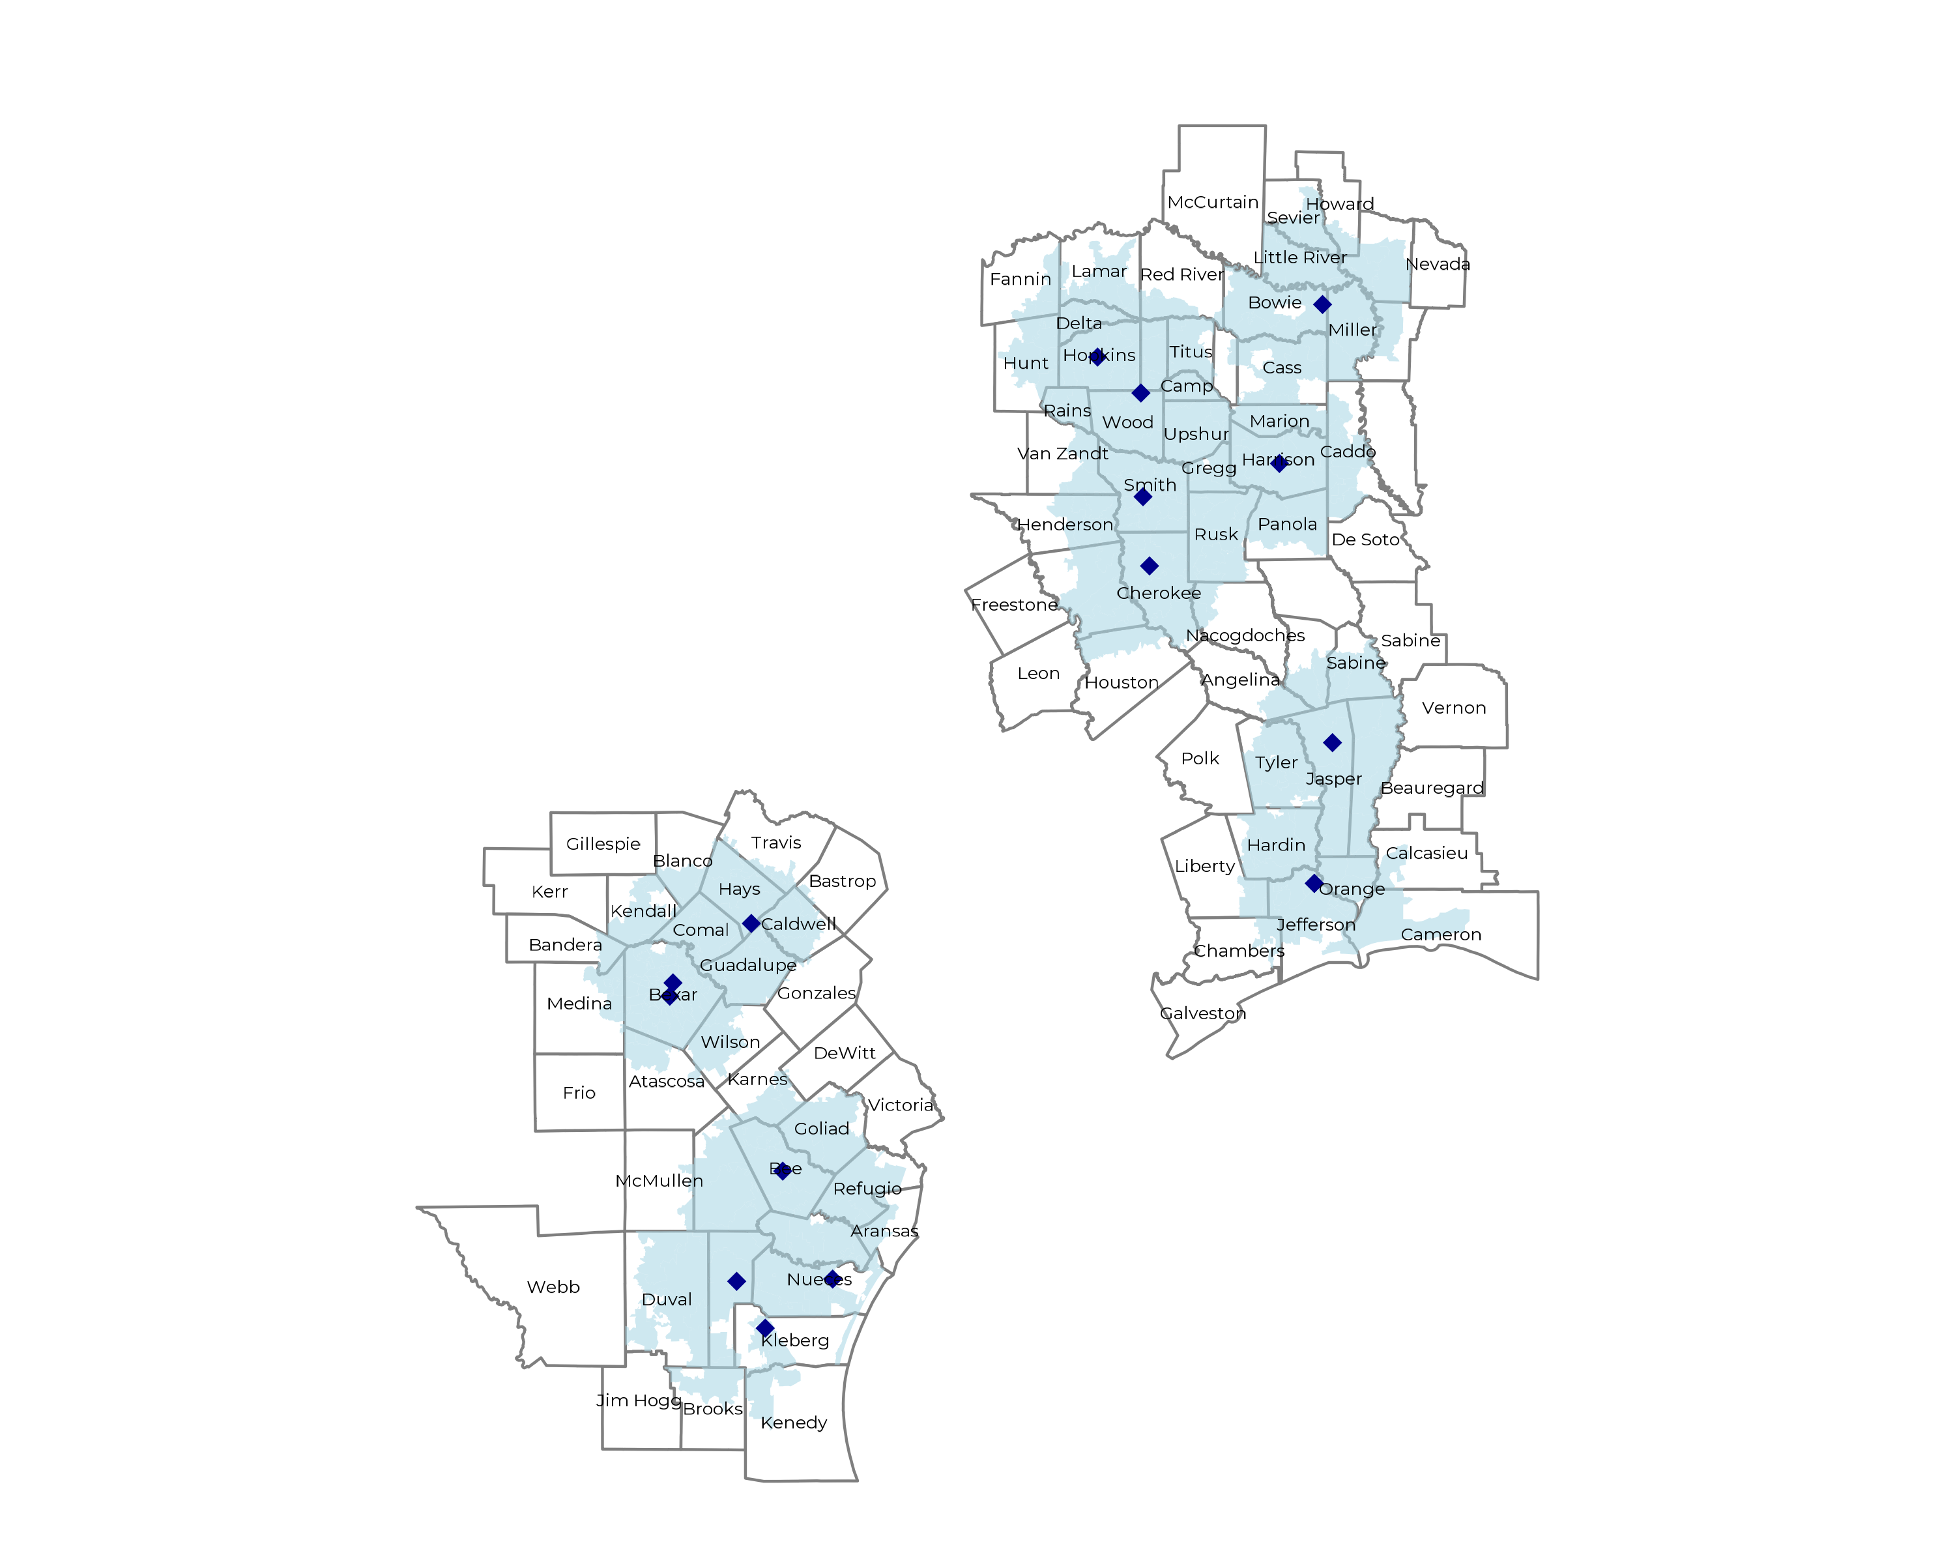
SIGNIFICANT OPPORTUNITY FOR PLAN GROWTH Researched for the below highlighted service area
Target Market 3,800+ Employers 830,000+ Employees 1.5M+ Members
 | Employer Size Group (# of Employees)
Commercial Employers With Headquarters | 50-100 | 101-200 | 201-400 | 401-1,000 | 1,001-3,000 | 3,000+
In Catchment Area | 2,016 | 900 | 543 | 308 | 86 | 58
Total Employees at Employers | 50-100 | 101-200 | 201-400 | 401-1,000 | 1,001-3,000 | 3,000+
Headquartered in Catchment Area | 151,200 | 135,000 | 162,900 | 215,600 | 172,000 | 348,000
Total Members with Employers | 50-100 | 101-200 | 201-400 | 401-1,000 | 1,001-3,000 | 3,000+
Headquartered in Catchment Area | 272,200 | 243,000 | 293,200 | 388,100 | 309,600 | 626,400

Slide 6
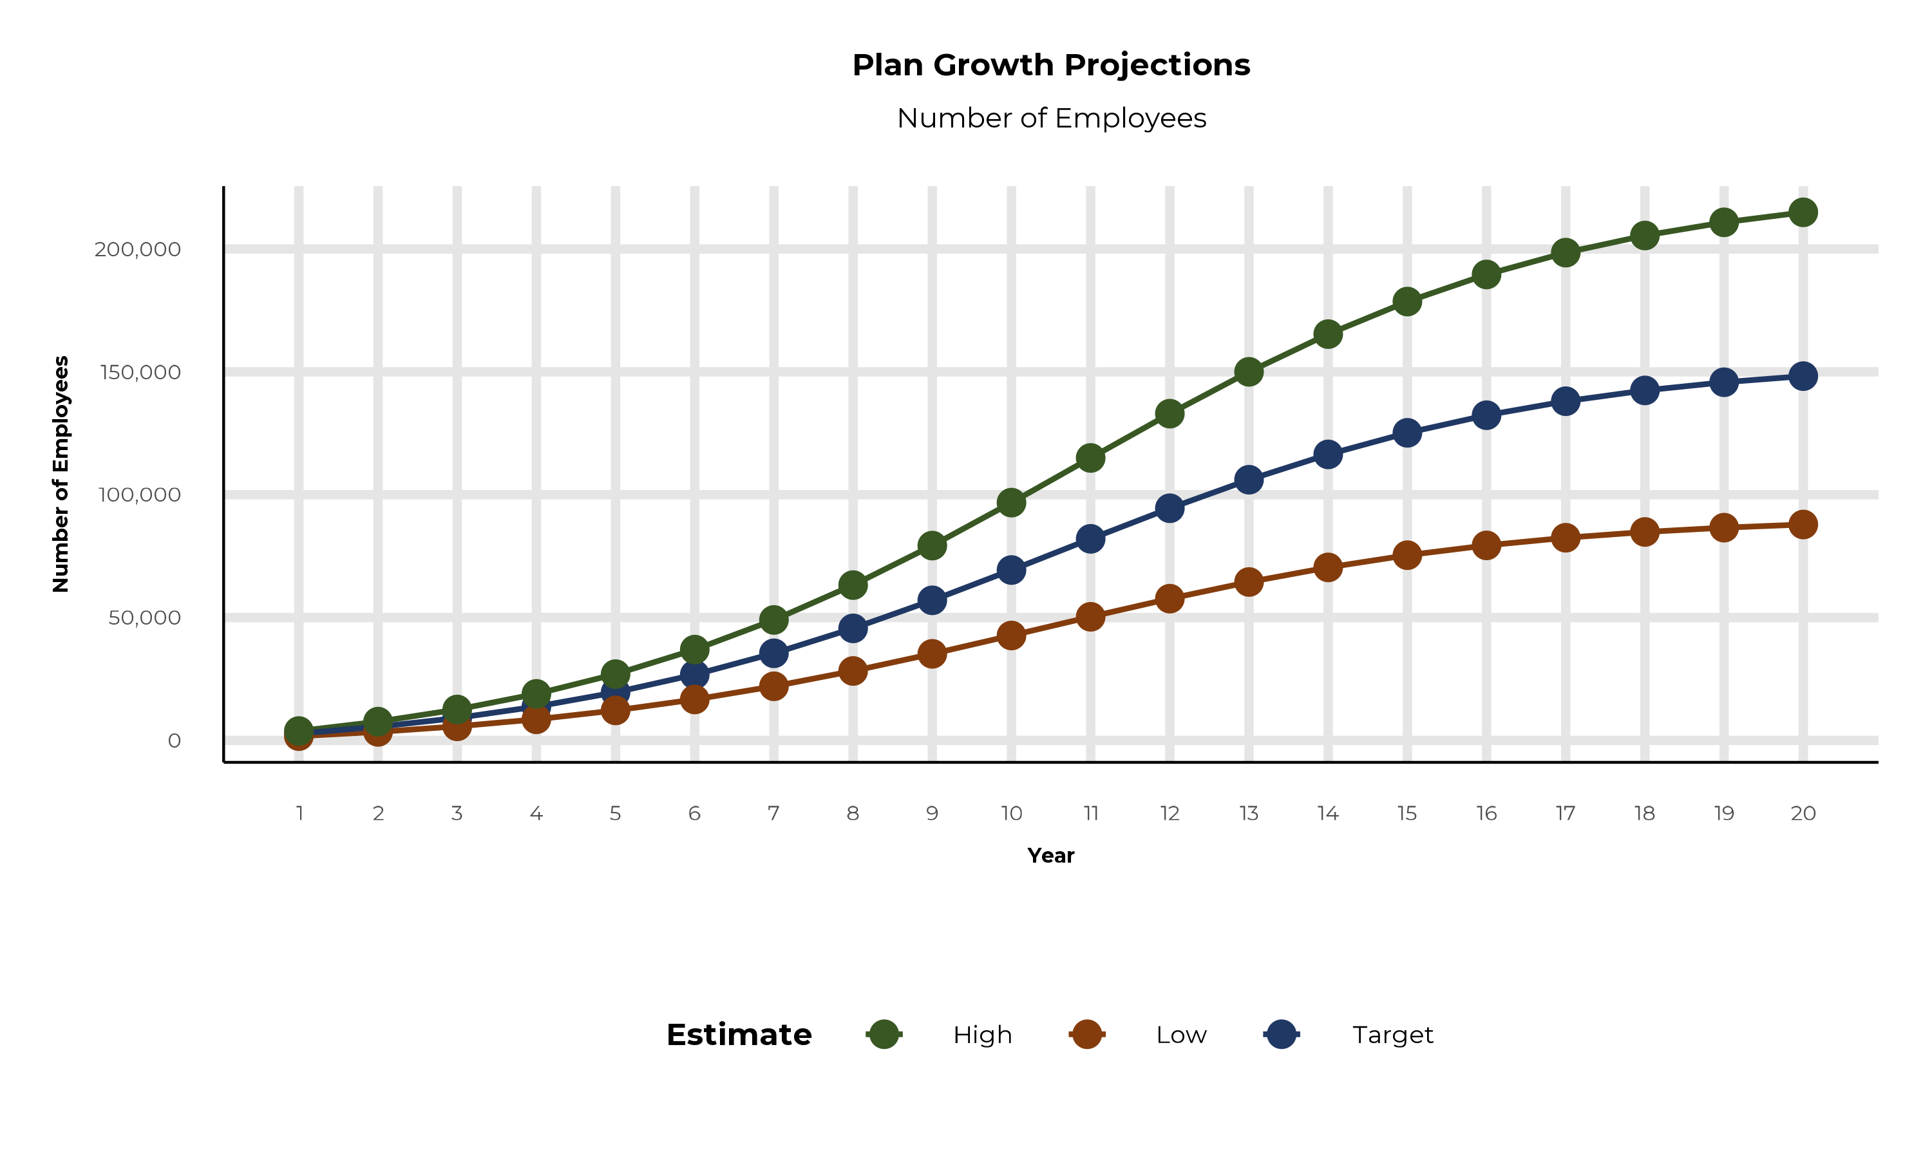
PLAN POTENTIAL GROWTH PATHS
Self Funded
1,016K
Insured
1,819K
Working Age
2,963K
Population
5,137K
Estimates includes the CHRISTUS Health service area in Hempstead, Howard, Lafayette, Little River, Miller, Sevier, Caddo, Calcasieu, Cameron, Anderson, Angelina, Aransas, Atascosa, Bandera, Bee, Bexar, Blanco, Bowie, Brooks, Caldwell, Camp, Cass, Chambers, Cherokee, Comal, Delta, Duval, Fannin, Franklin, Goliad, Gregg, Guadalupe, Hardin, Harrison, Hays, Henderson, Hopkins, Houston, Hunt, Jasper, Jefferson, Jim Wells, Karnes, Kendall, Kenedy, Kleberg, Lamar, Liberty, Live Oak, Marion, Medina, Morris, Nacogdoches, Newton, Nueces, Orange, Panola, Rains, Red River, Refugio, Rusk, Sabine, San Augustine, San Patricio, Smith, Titus, Travis, Tyler, Upshur, Van Zandt, Wilson, and Wood Counties

Slide 7
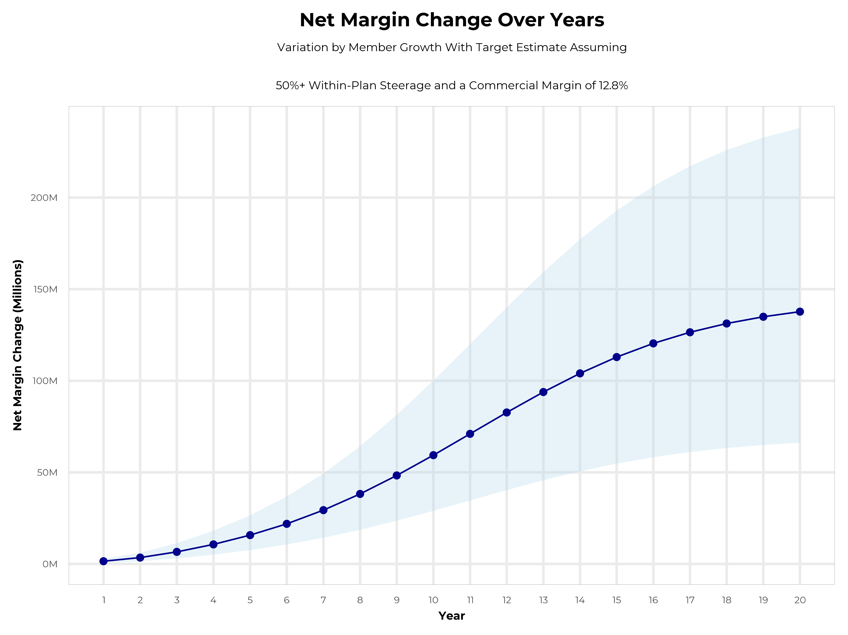
GROWING POWERFUL, LASTING PROFITABILITY
Early Stage
Gaining Name Recognition, Early Growth
New Revenue:
New Profit:
$77.15M
$9.98M
Growth Stage
Strong Reputation, Strong Growth
New Revenue:
New Profit:
$460.23M
$60.41M
Mature Stage
High Profitability, Market Saturation
New Revenue:
New Profit:
$944.52M
$123.97M

Slide 8
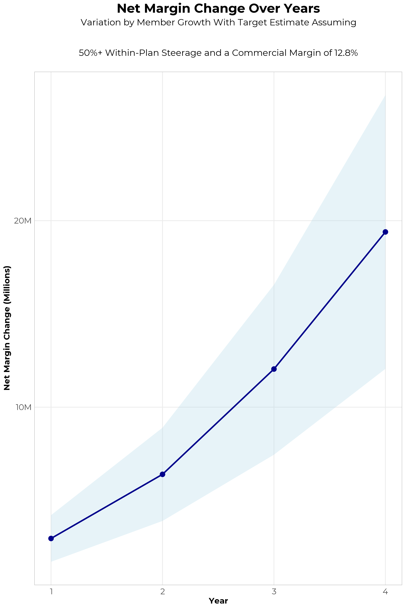
FOUR-YEAR PROJECTIONS
Target Member Growth | Target Member Growth | Target Member Growth | Target Member Growth | Target Member Growth
Metric | Year 1 | Year 2 | Year 3 | Year 4
Number of Members | 5,000 | 10,000 | 16,500 | 24,800
Incremental Margin | 3,229.4K | 6,458.8K | 12,026.6K | 19,278.0K
Network Access Fee | 60.0K | 120.0K | 198.0K | 297.6K
Implementation Fee (One-Time) | -150.0K | 0.0K | 0.0K | 0.0K
Sales and Marketing Costs | -180.0K | -180.0K | -180.0K | -180.0K
Net Margin Change | 2,959.4K | 6,398.8K | 12,044.6K | 19,395.6K
High Member Growth | High Member Growth | High Member Growth | High Member Growth | High Member Growth
Metric | Year 1 | Year 2 | Year 3 | Year 4
Number of Members | 6,900 | 13,800 | 22,600 | 34,100
Incremental Margin | 4,456.6K | 8,913.2K | 16,472.8K | 26,507.2K
Network Access Fee | 82.8K | 165.6K | 271.2K | 409.2K
Implementation Fee (One-Time) | -150.0K | 0.0K | 0.0K | 0.0K
Sales and Marketing Costs | -180.0K | -180.0K | -180.0K | -180.0K
Net Margin Change | 4,209.4K | 8,898.8K | 16,564.0K | 26,736.4K
Low Member Growth | Low Member Growth | Low Member Growth | Low Member Growth | Low Member Growth
Metric | Year 1 | Year 2 | Year 3 | Year 4
Number of Members | 3,100 | 6,200 | 10,300 | 15,500
Incremental Margin | 2,002.2K | 4,004.5K | 7,507.5K | 12,048.7K
Network Access Fee | 37.2K | 74.4K | 123.6K | 186.0K
Implementation Fee (One-Time) | -150.0K | 0.0K | 0.0K | 0.0K
Sales and Marketing Costs | -180.0K | -180.0K | -180.0K | -180.0K
Net Margin Change | 1,709.4K | 3,898.9K | 7,451.1K | 12,054.7K

Slide 9

THE BENEFIT STEERING THE PATIENT TO CHRISTUS
What Will this Claim Cost Me?
Explanation of Benefits
Heart Attack, Cardiac Surgery
THE CHARGES
Medical Bills | $25,000
Healthcare out-of-pocket due to provider | $4,500
Since your out of pocket maximum has been met, the rest of your eligible charges this year will be paid at 100%
THE CREDITS
OP Radiology/X-Ray | $200
OP Diagnostic Labs | $100
Preferred Hospital Stay ($500/day, 5 days) | $2,500
Critical Illness Benefit | $2,000
Health Screening Benefit | $125
Benefit Total | $4,925
Out of Pocket Paid to Hospital | ($4,500)
Balance Paid to HGA | $425
CHRISTUS Health patients can have all out-of-pocket liability reduced to $0!

Slide 10
PROJECTED PLAN GROWTH
Year | Employees | Members | Percent of Members Choosing CHRISTUS Health for Inpatient Care | Percent of Members Choosing CHRISTUS Health for Outpatient Care
1 | 2,800 | 5,000 | 60% | 50%
2 | 5,600 | 10,100 | 60% | 50%
3 | 9,100 | 16,400 | 65% | 55%
4 | 13,800 | 24,800 | 67% | 58%
5 | 19,600 | 35,300 | 68% | 60%
6 | 26,800 | 48,200 | 68% | 60%
7 | 35,400 | 63,700 | 69% | 61%
8 | 45,600 | 82,100 | 69% | 62%
9 | 57,000 | 102,600 | 69% | 62%
10 | 69,300 | 124,700 | 70% | 63%
11 | 82,000 | 147,600 | 70% | 63%
12 | 94,500 | 170,100 | 70% | 64%
13 | 106,100 | 191,000 | 71% | 64%
14 | 116,400 | 209,500 | 71% | 65%
15 | 125,200 | 225,400 | 71% | 66%
16 | 132,400 | 238,300 | 72% | 66%
17 | 138,000 | 248,400 | 72% | 66%
18 | 142,400 | 256,300 | 72% | 67%
19 | 145,800 | 262,400 | 72% | 67%
20 | 148,300 | 266,900 | 72% | 67%
KBA currently estimates that CHRISTUS Health has 18% inpatient market share, and 15% outpatient market compared to hospitals/clinics in the CHRISTUS Health service area (see slide 8).
Based on previous DTE experience, KBA expects a significant bump in patient steerage to CHRISTUS Health.
Additional steerage will occur from additional steerage patient benefits and the patient convenience card.
High estimates start nearly 10% higher than target with low estimates at 10% lower than target

Slide 11
YEAR 4 PROJECTED REVENUE AND PROFIT
Pre-DTE Cohort of 24,800 Employees | Inpatient | Outpatient | Professional | Total
Revenue† | $ 16,250,485 | $ 24,157,915 | $ 11,281,541 | $ 51,689,940
Net Income‡ | $ 2,080,062 | $ 3,092,213 | $ 1,444,037 | $ 6,616,312
† Assuming proportional revenues from market shares of 18% (inpatient) and 15% (outpatient)
‡ Conservatively assuming a commercial margin of 12.8% (80% of the estimated commercial margin)
With DTE | Inpatient | Outpatient | Professional | Total
Revenue⁰ | $ 60,589,772 | $ 95,013,825 | $ 44,370,649 | $ 199,974,246
Net Income* | $ 7,755,491 | $ 12,161,770 | $ 5,679,443 | $ 25,596,704
⁰ Assuming 67% inpatient and 58% market steerage based on KBA narrow network DTE experience (see previous slide)
* Conservatively assuming a commercial margin of 12.8%, with a 10 percentage-point reduction to reflect competitive-edge rates and a 10 percentage-point increase due to lower billing costs and higher patient responsibility collections because of the member convenience card.
Total Increase in Net Income | $ 18,980,391
Network Access Fee (Revenue) of $1 PMPM | $ 297,600
Total Profit Growth | $ 18,985,191
Minus Implementation Fee (One-Time) | -$ 0
Minus Sales and Marketing (Annual – Ongoing) | -$ 180,000
Total | $ 19,097,991

Slide 12





A PARTNER YOU CAN TRUST
OUR OBJECTIVES ARE ALIGNED
WE KNOW THE
MARKET
COMPLETELY TRANSPARENT
WE HAVE THE SOPHISTICATION AND INFRASTRUCTURE TO EFFECTIVELY COMPETE
Derek Moore, Senior Vice President – KBA
845-283-9973 * derek.moore@keybenefit.com

